Slide 1
An R package for clustering and visualizing ancient DNA signatures
By Hussein Al-Asadi & Kushal Dey

Slide 2
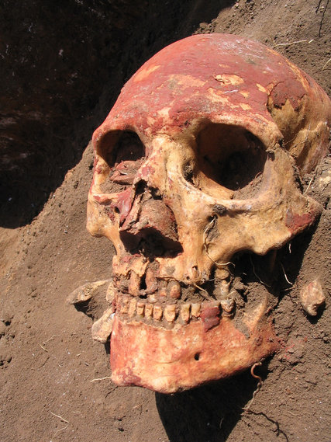
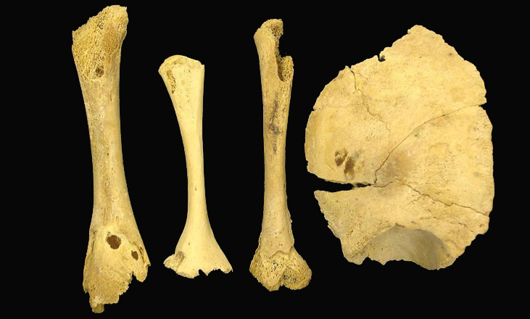
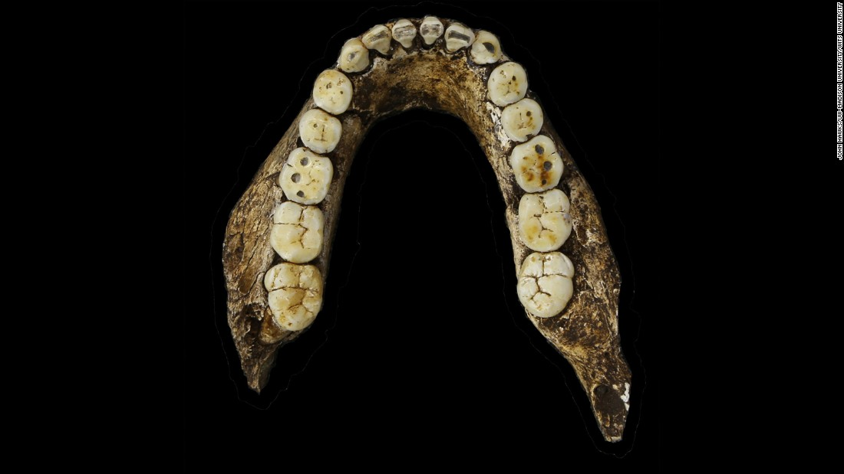
Ancient DNA sites

Slide 3
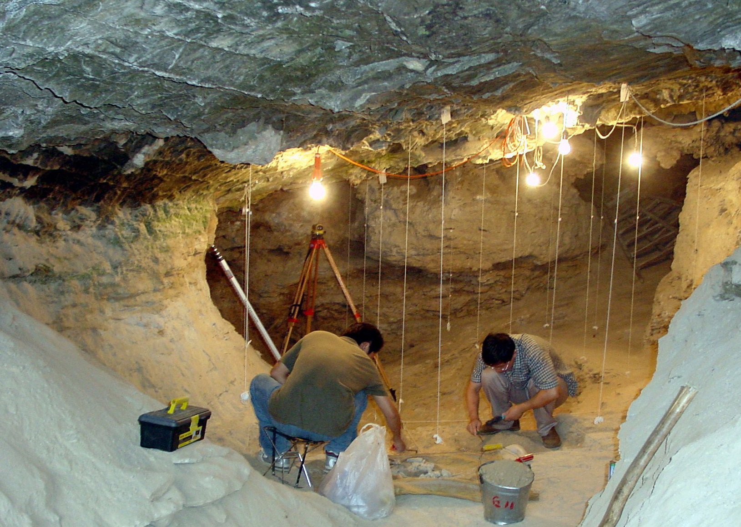
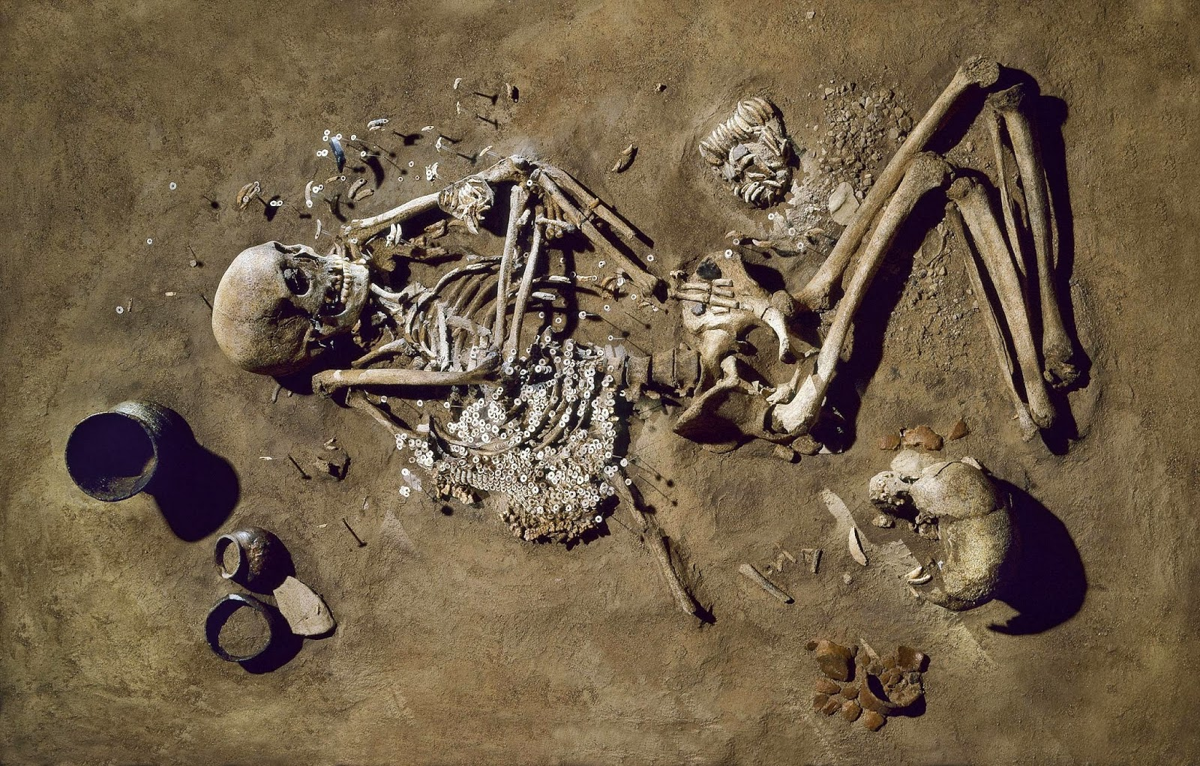
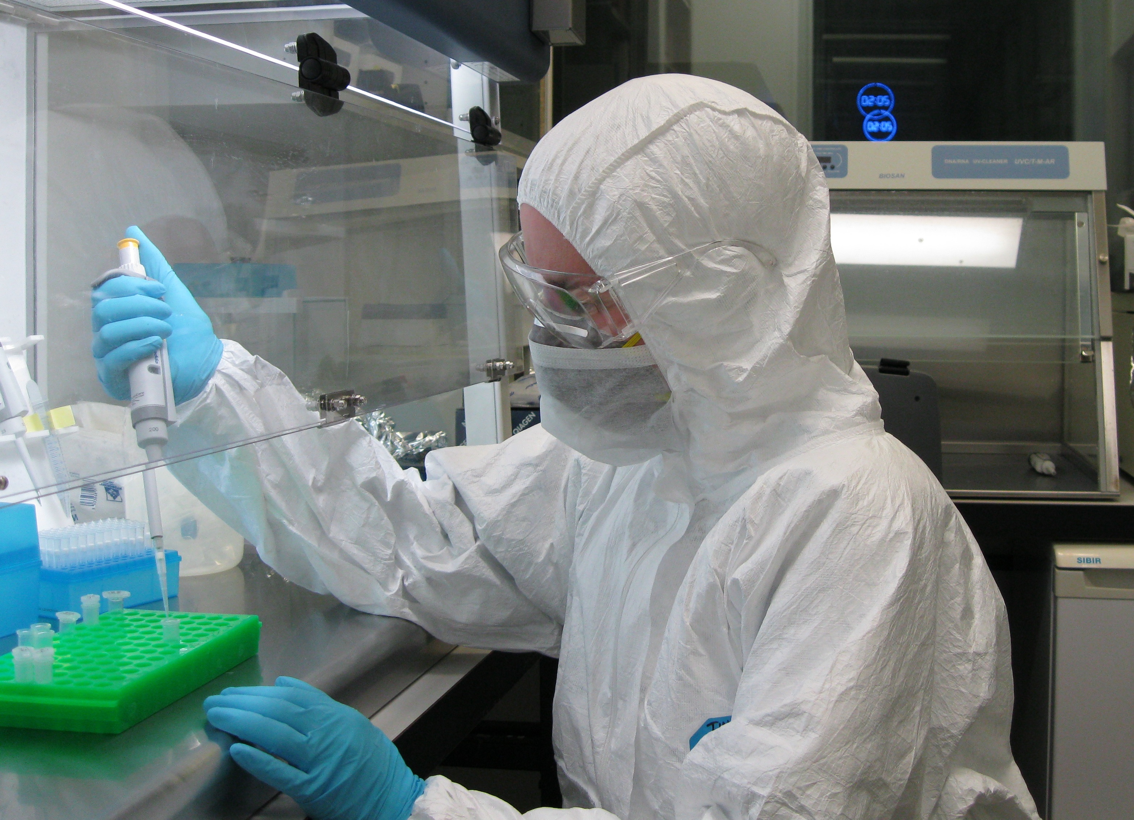
samples
collection
sequencing

Slide 4
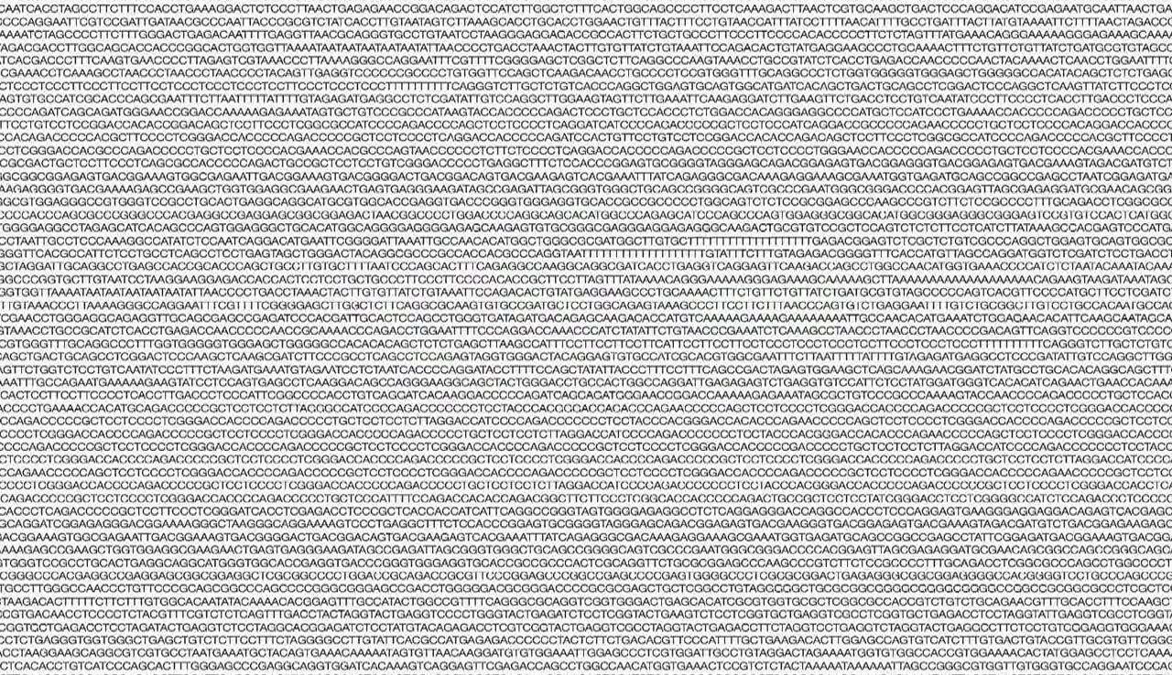
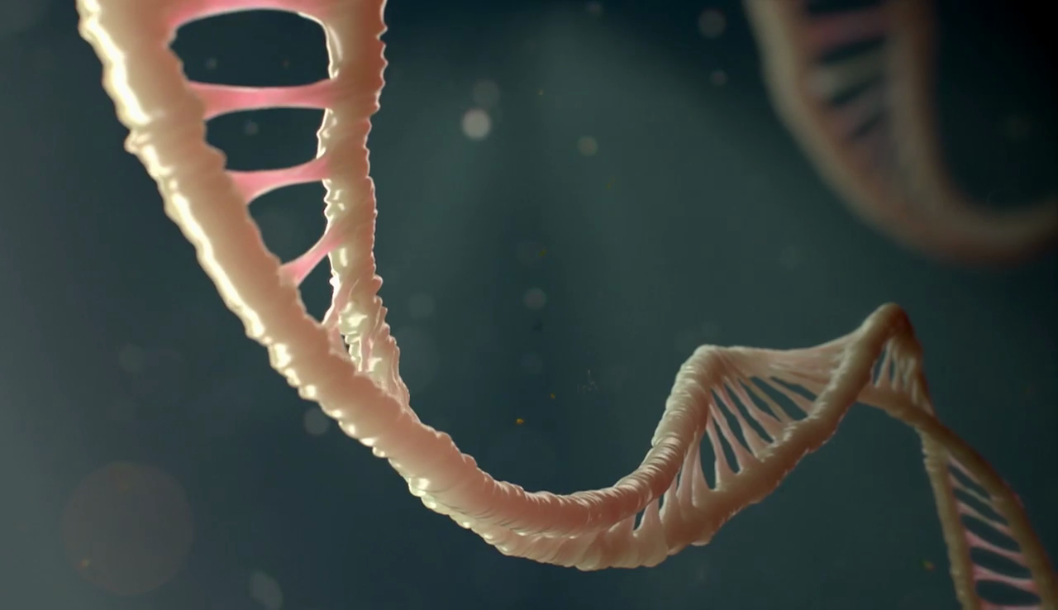
Notes:
We get long sequences from modern DNA and we can kind of get a complete representation of the genome because of the massive amount of DNA we maneg to collect from moderns.

Slide 5
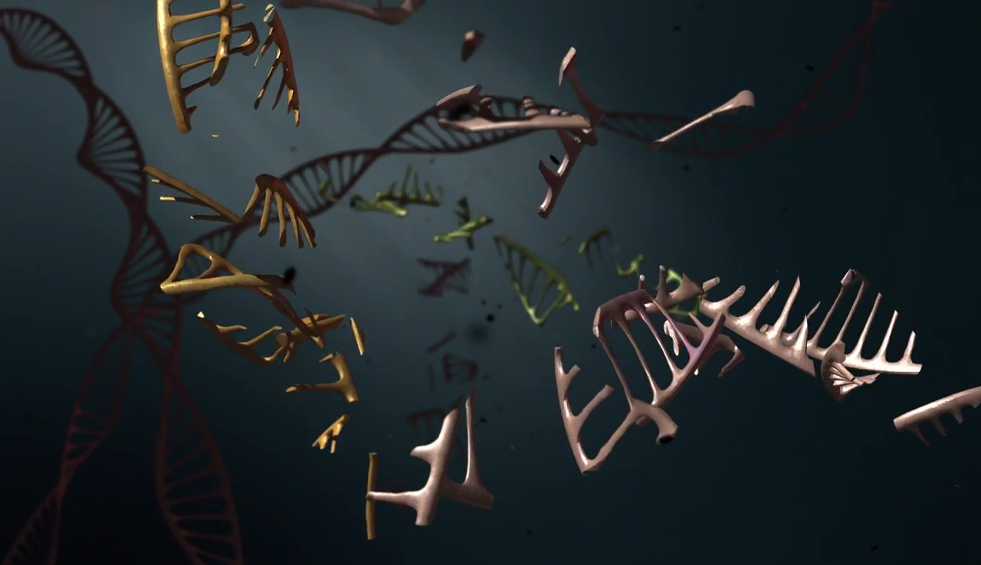
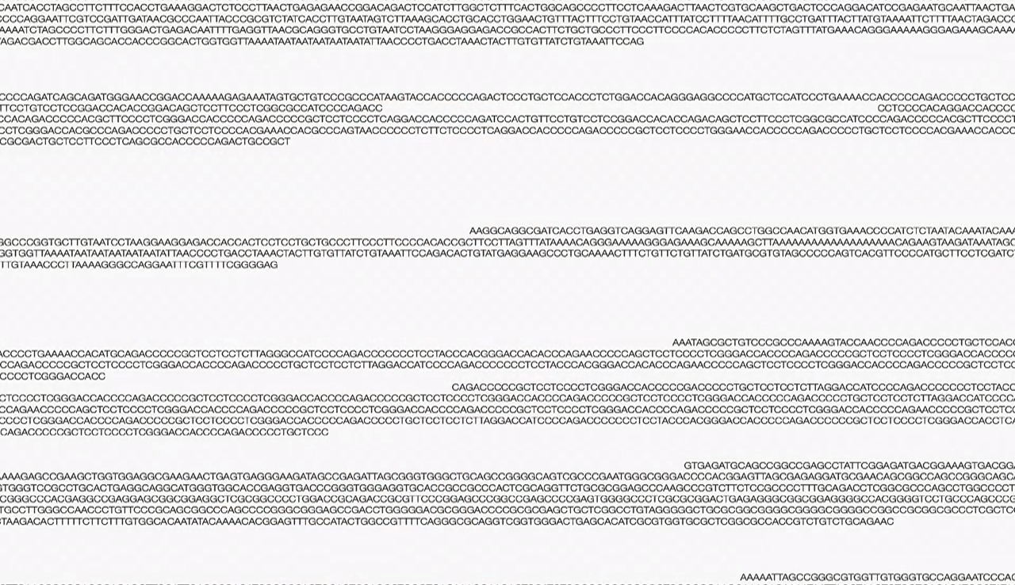
Notes:
What causes this fragmentation? Water, UV radiation etc etc. Also the decay rate depends on how the DNA is preserved, if in a cold region like the Arctic or like in a cave, they are supposed to be well preserved, and the decay rate is slow.

Slide 6
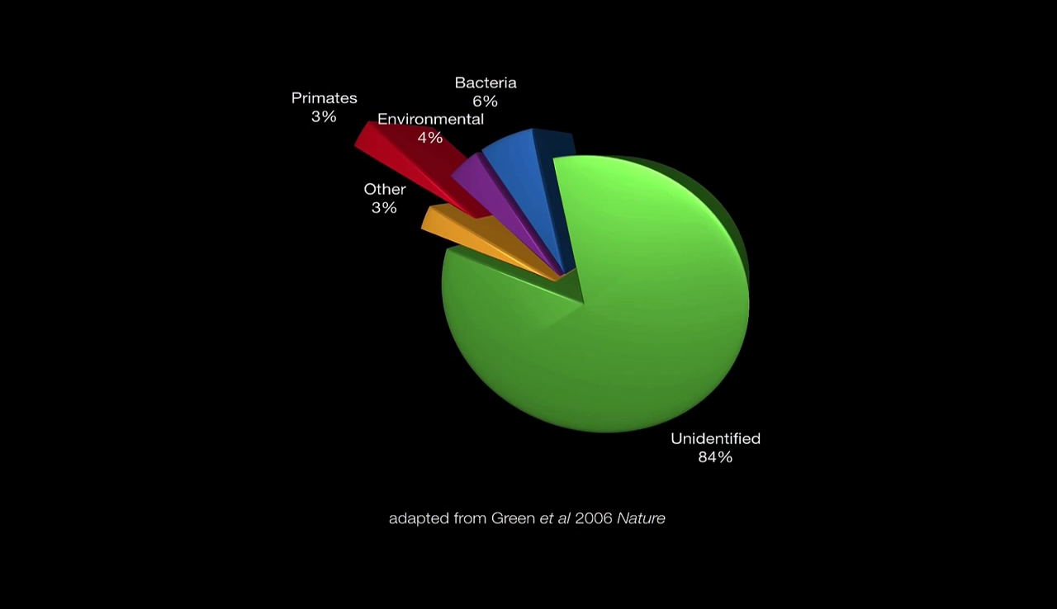
Notes:
So it seems only a small percentage of the DNA that is collected from these samples actually correspond to the actual ancient DNA we are interested in (the primates). Then also we are not sure if those primates actually are modern or ancient. It could be modern DNA because of the handling of the DNA at the site or in lab.

Slide 7
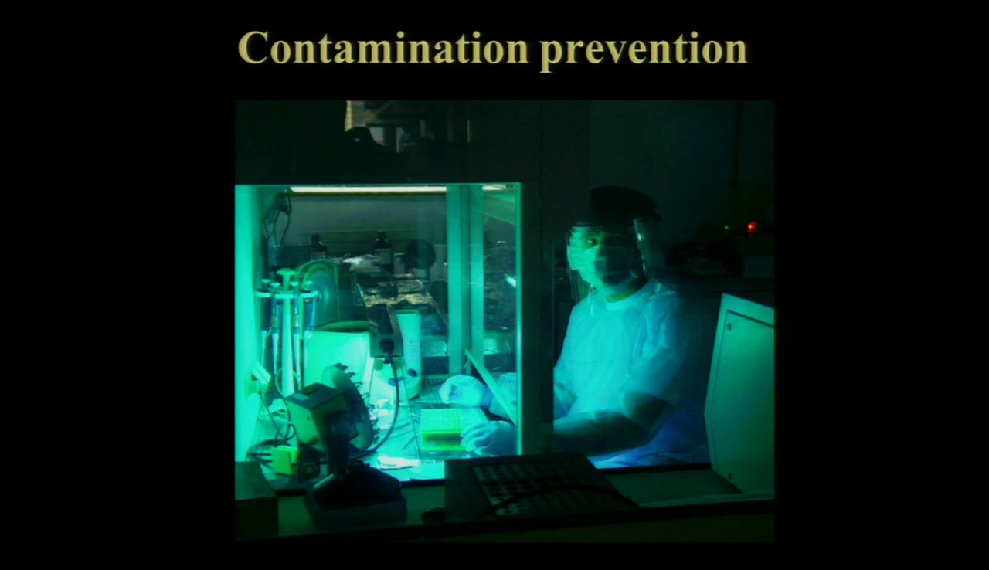
Notes:
This is why we take all sorts of measures in the lab to keep modern DNA away from ancient DNA. Looks like a picture out of a sci-fi movie about virus outbreak, but we are the danger here

Slide 8
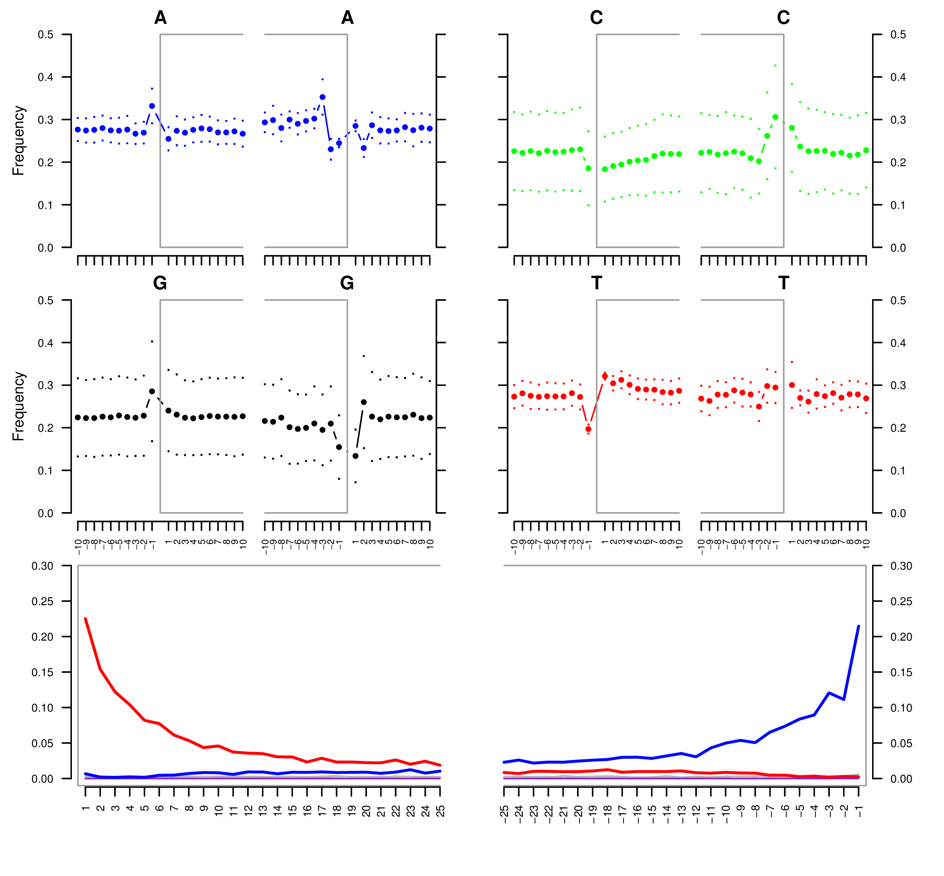
C->T
G->A
5’ end of fragment
3’ end of fragment

Slide 9
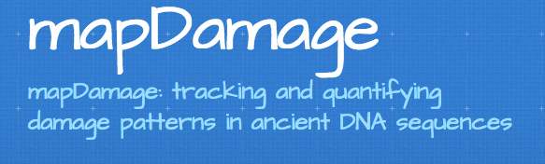

Slide 10
Data-set # 1
DiRenzio Lab: 48 Ancients and 7 control samples
Questions:
Do the ancients look “ancient”?
Is there any DNA in the the controls?
If so, is the DNA modern or ancient?

Slide 11
MapDamage on Ancients
CNE1
KS20
Shorter
S30
Steeper

Slide 12
MapDamage on Controls
C->T trend
C->T trend
Notes:
LABEL THE PLOTS

Slide 13
MapDamage on Moderns
HG00097
C->T trend
HG00099

Slide 14
MapDamage on Ancient Sards. (different data-set)
C->T trend

Slide 15
Thoughts…
It’s not clear what is an “ancient” C->T damage profile and what is an “modern” profile?
Difficult to perform comparative analysis
MapDamage is an individual-by-individual analysis
Hard to look at all plots simultaneously
Are we missing other patterns?

